Slide 1
IRS Migration
to AWS
-TEAM ARYAN

Slide 2
Introduction
The Indian Railways System (IRS) is one of the world's largest railway networks, serving millions of passengers and freight operations daily. The system relies on a highly complex IT infrastructure for managing ticketing, train scheduling, freight logistics, and real-time monitoring. However, with increasing demand, scalability challenges, and security concerns, the need for a modern, cloud-based infrastructure has become essential.
To address these challenges, migrating the IRS platform to AWS (Amazon Web Services)
offers a highly scalable, secure, and cost-efficient solution. This migration will:
Enhance system performance with faster processing and reduced downtime.
Improve data security with AWS encryption, backups, and disaster recovery solutions.
Optimize costs by shifting from on-premise infrastructure to cloud-based resources.
This presentation explores the features, functionalities, architecture, and
resource consumption of IRS while evaluating the benefits and challenges
of migration to AWS

Slide 3
Working of the IRS Platform
Overview
The Indian Railways System (IRS) is a real-time platform managing ticketing, freight logistics, and train scheduling, integrating with IRCTC, RailTel, and logistics providers.
Key Features
Real-Time Ticketing – Millions of transactions daily, secure payments, fraud detection.
AI-Powered Scheduling – Dynamic rescheduling, delay reduction, route optimization.
Freight & Logistics – Automated tracking, demand forecasting, predictive maintenance.

Slide 4
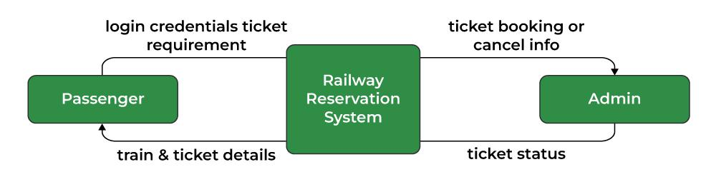
Features
Functionalities
Scalable Ticketing System – Handles millions of bookings with secure transactions
AI-Driven Train Scheduling – Uses real-time data to optimize train timings and reduce delays.
Smart Freight Management – Enables automated cargo tracking and demand forecasting.
Robust Security Framework – Implements encryption, multi-factor authentication, and data recovery.
Seamless Passenger Services – Supports e-ticketing, mobile app integration, and automated refunds.
Real-Time Train Tracking – Uses GPS for live location updates and delay predictions.
Predictive Analytics – AI-powered insights for demand forecasting and operational efficiency.
Secure Data Management – Protects transactions with encryption and cloud storage solutions

Slide 5
Architecture of IRS Platform
Pre-Migration Architecture (On-Premises)
Data Centers: Managed by RailTel, hosting IRS databases & applications.
High Latency Issues: Due to centralized servers handling high load.
Limited Scalability: Hard to expand during peak hours.
Post Migration Architecture (AWS)
AWS EC2 for computing power, Auto Scaling for handling peak loads.
Amazon RDS for relational database management, improving efficiency.
AWS Lambda for serverless functions (real-time data processing).
Amazon S3 for secure, cost-effective storage of passenger records.
CloudFront CDN for faster content delivery & lower bandwidth costs

Slide 6
Consumption of the IRS
Bandwidth
Storage
Processing requirements

Slide 7
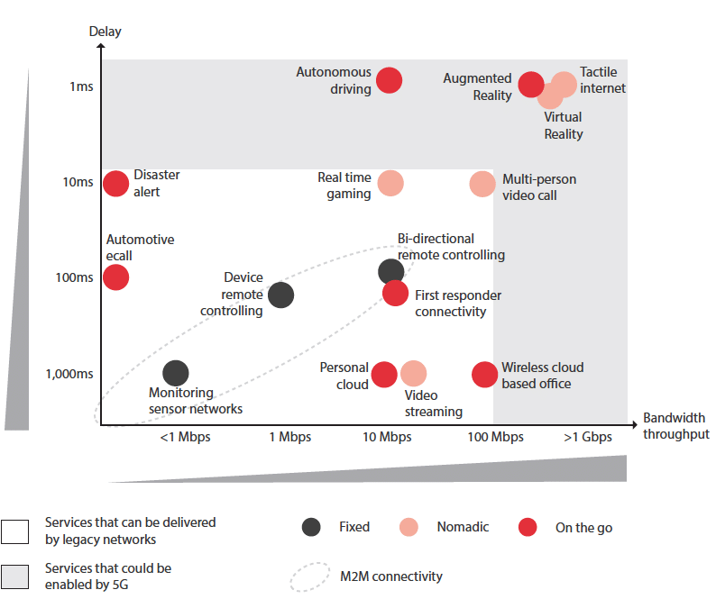
Bandwidth
Access Layer: Railway stations are equipped with a minimum of STM-4 (625 Mbps) bandwidth, ensuring efficient data transmission for passenger services and operations.
Edge Layer: Key locations utilize STM-16 (2.5 Gbps) or STM-64 (10 Gbps) links, aggregating data from multiple stations to regional hubs.
Backbone Layer: Major cities and towns are interconnected using Dense Wavelength Division Multiplexing (DWDM) technology, providing multiple 10 Gbps channels to handle extensive data traffic.

Slide 8
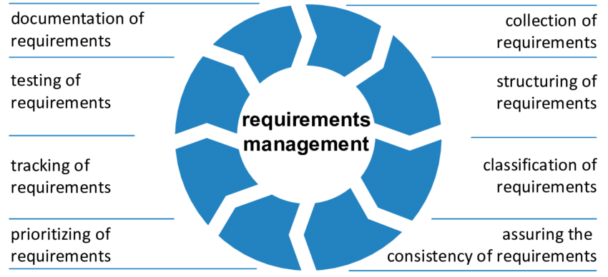
Storage
Centralized Data Centers: RailTel operates data centers in Secunderabad and Gurugram, offering services like hosting, co-location, and secure, energy-efficient infrastructure.
Edge Data Centers: Plans include establishing edge data centers at 102 locations, each with an initial capacity of approximately 20 racks (5 KW to 10 KW each), enhancing localized data processing and storage

Slide 9
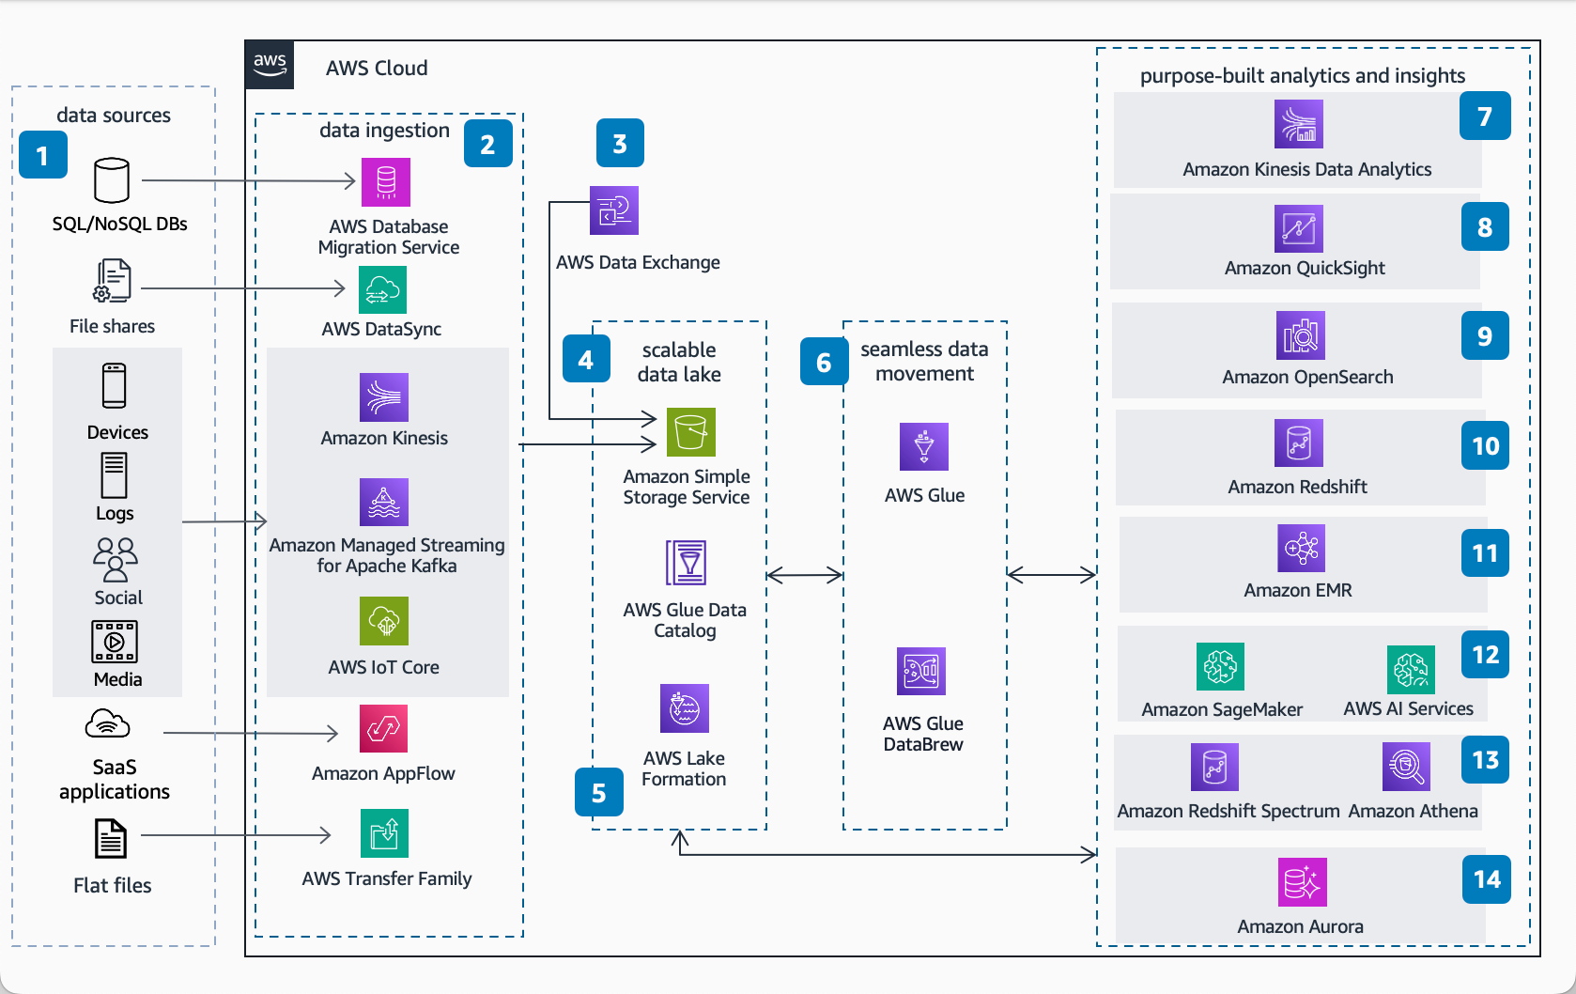
Processing requirements
Scalability: The IRS leverages cloud hosting solutions to dynamically scale computing resources, ensuring high availability and secure data processing environments.
Data Analytics: Advanced analytics are employed for predictive maintenance, train scheduling optimization, and operational efficiency, necessitating robust computing infrastructure

Slide 10
PROCESS OF MIGRATING EXISTING IRS TO AWS

Slide 11
Which Of The 6 Rs ?
Replatform : For Core Services
Refactor : For Future Scalability
Rehost : For Quick Migration

Slide 12
Migrating the Indian Railway system to AWS (Amazon Web Services) is a complex, multi-faceted project that involves careful planning, execution, and management.
DISCOVERY AND INVENTORY
ASSESSMENT AND PLANNING
SETUP AWS ENVIRONMENT
DATA MIGRATION
APPLICATION MIGRATION
TESTING AND VALIDATION
OPTIMIZATION AND PERFORMANCE TUNING
SECURITY AND COMPLIANCE
TRAINING AND KNOWLEDGE TRANSFER
GO-LIVE AND POST-MIGRATION SUPPORT

Slide 13
Potential Challenges in the Migration Process
Scale and Complexity: The Indian Railway system is one of the largest in the world, making migration a massive undertaking.
Downtime: Minimizing downtime during migration is critical to avoid disrupting services.
Legacy Systems: Many existing systems may not be cloud-ready and require significant rework.
Data Security: Ensuring the security of sensitive passenger and operational data.
Regulatory Compliance: Adhering to Indian government regulations and data localization laws.
Skill Gaps: Bridging the gap in cloud expertise among existing staff.

Slide 14
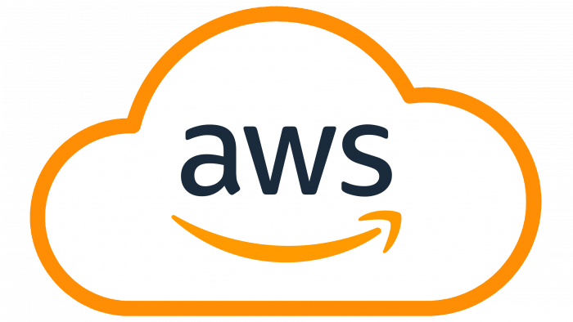
AWS SERVICES USED IN IRS

Slide 15
AWS Services Used for Indian Railways System Migration
EC2 (Elastic Compute Cloud) - Primary compute resources for web, API, booking, and Tatkal servers
RDS (Relational Database Service) - Primary transactional database with Multi-AZ deployment
DynamoDB - NoSQL database for high-throughput workloads (real-time ticket status, train schedules)
VPC (Virtual Private Cloud) - Network isolation and security foundation
S3 (Simple Storage Service) - Data lake and log storage
IAM (Identity and Access Management) - Core security service for access control
CloudWatch - Monitoring, alerting, and operational insights
Auto Scaling - Dynamic resource provisioning for ticket booking peak loads

Slide 16
Why not other services ?
AWS Elastic Beanstalk is easier to manage but doesn’t provide the granular control needed for a large, complex system like Indian Railways.
Amazon Aurora might be considered if you need MySQL/PostgreSQL compatibility with higher throughput, but RDS engines are often sufficient and can be more cost-effective.
Amazon EFS is better for shared file storage among multiple EC2 instances but may not always match the performance profile required for heavy transactional databases.
AWS X-Ray is specialized for tracing distributed applications (e.g., microservices). Indian Railways may use it if they break applications into microservices, but CloudWatch and CloudTrail remain the core for system-wide visibility.
Third-party security solutions exist, but AWS native services integrate tightly with other AWS resources and provide a unified security model.

Slide 17
AWS MIGRATION TOOLS
AWS Migration Hub-provides a single location to track the progress of application migrations across multiple AWS and partner solutions.
AWS Application Discovery Service-collects and presents configuration, usage, and behavior data from your servers to help you plan your migration.
AWS Server Migration Service (SMS)-an agentless service for migrating thousands of on-premises workloads to AWS.
AWS Database Migration Service (DMS)-helps you migrate databases to AWS. The source database remains fully operational during the migration.
AWS Snowball-a petabyte-scale data transport solution that uses secure appliances to transfer large amounts of data into and out of AWS.
AWS Snowmobile-an exabyte-scale data transfer service used to move extremely large amounts of data to AWS.
AWS Direct Connect-lets you establish a dedicated network connection line between your network and one of the AWS Direct Connect locations.
Amazon Kinesis Firehose-a fully managed service for loading streaming data into AWS.
AWS Marketplace-where you can purchase different types of software and licenses offered by AWS Partners and other AWS Users.

Slide 18
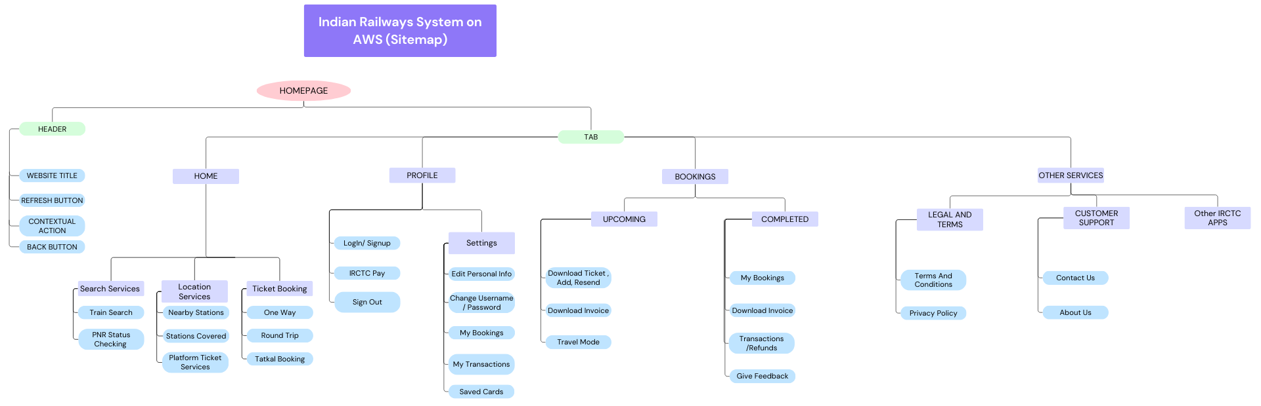

Slide 19
Designing the Architecture Diagram
Important Factors to consider :
1. Disaster Recovery and Backup Mechanisms
2. Security and Compliance Practices
3. Cost Reduction strategies

Slide 20
Disaster Recovery
Multi-AZ RDS Deployment: Automatic failover within the same region
Cross-Region Replication: For critical data in S3 and DynamoDB
AWS Backup Service: Centralized backup with point-in-time recovery
Glacier Storage: Immutable, long-term archives for compliance
Automated Recovery Procedures: Using CloudWatch Events and Lambda

Slide 21
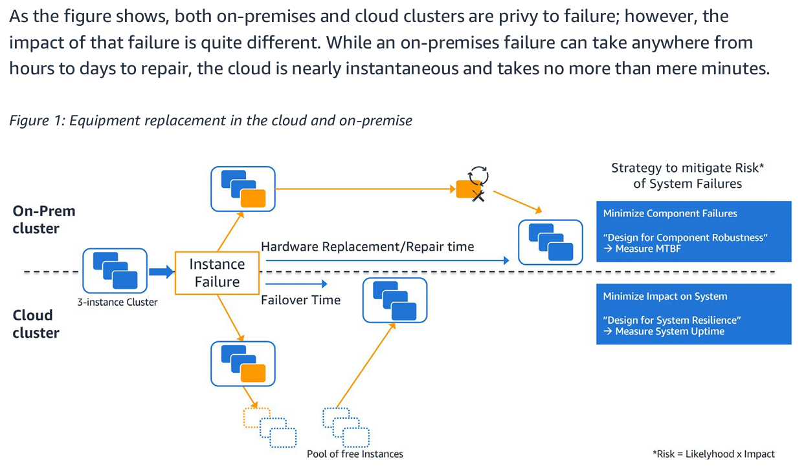

Slide 22
Security and
Compliance Practices
Defense-in-Depth Strategy:
Edge protection (Shield, WAF)
Network isolation (VPC, subnets)
Access control (IAM, Cognito)
Data encryption (in-transit and at-rest)
Compliance Controls:
CloudTrail for comprehensive audit trails
Config for resource compliance monitoring
S3 logs with retention policies
Immutable backups in Glacier
PII Data Protection:
Encryption for sensitive passenger information
Access controls with least privilege
Monitoring for unusual access patterns

Slide 23
Cost Optimization vs. On-Premises
Right-Sizing Strategies:
Auto-scaling instead of peak capacity provisioning
Serverless for intermittent workloads
Reserved Instances for predictable base loads
Storage Tiering:
S3 for active data
Glacier for archives (replacing physical storage)
Operational Cost Reduction:
Elimination of physical data centers
Reduced administrative overhead
Pay-as-you-go model for seasonal demands (e.g., holiday bookings)
Cost Monitoring:
CloudWatch for resource utilization analysis
Budget alerts and optimization recommendations

Slide 24
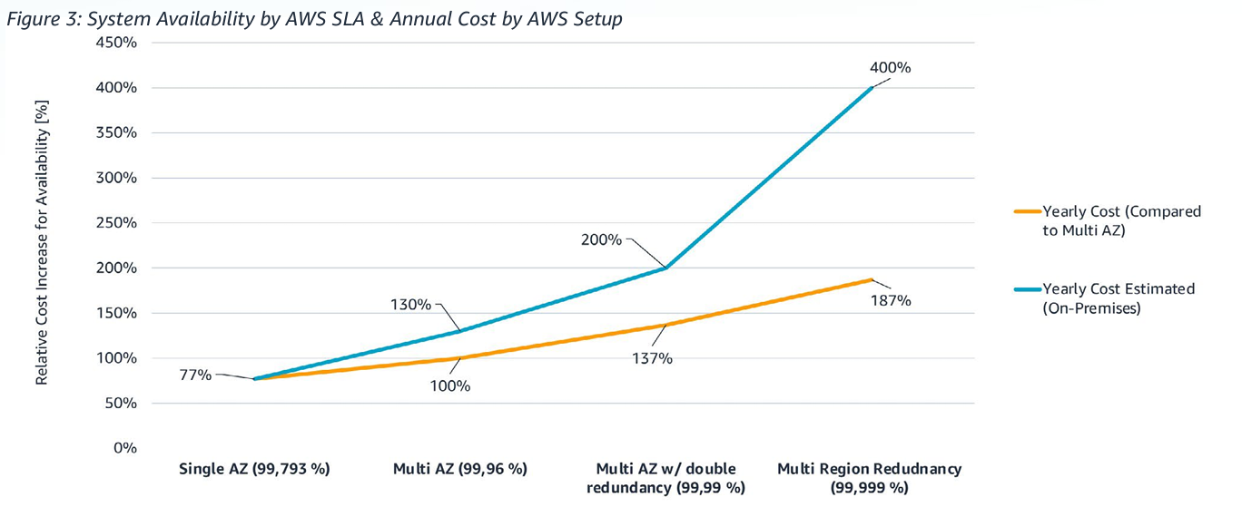

Slide 25
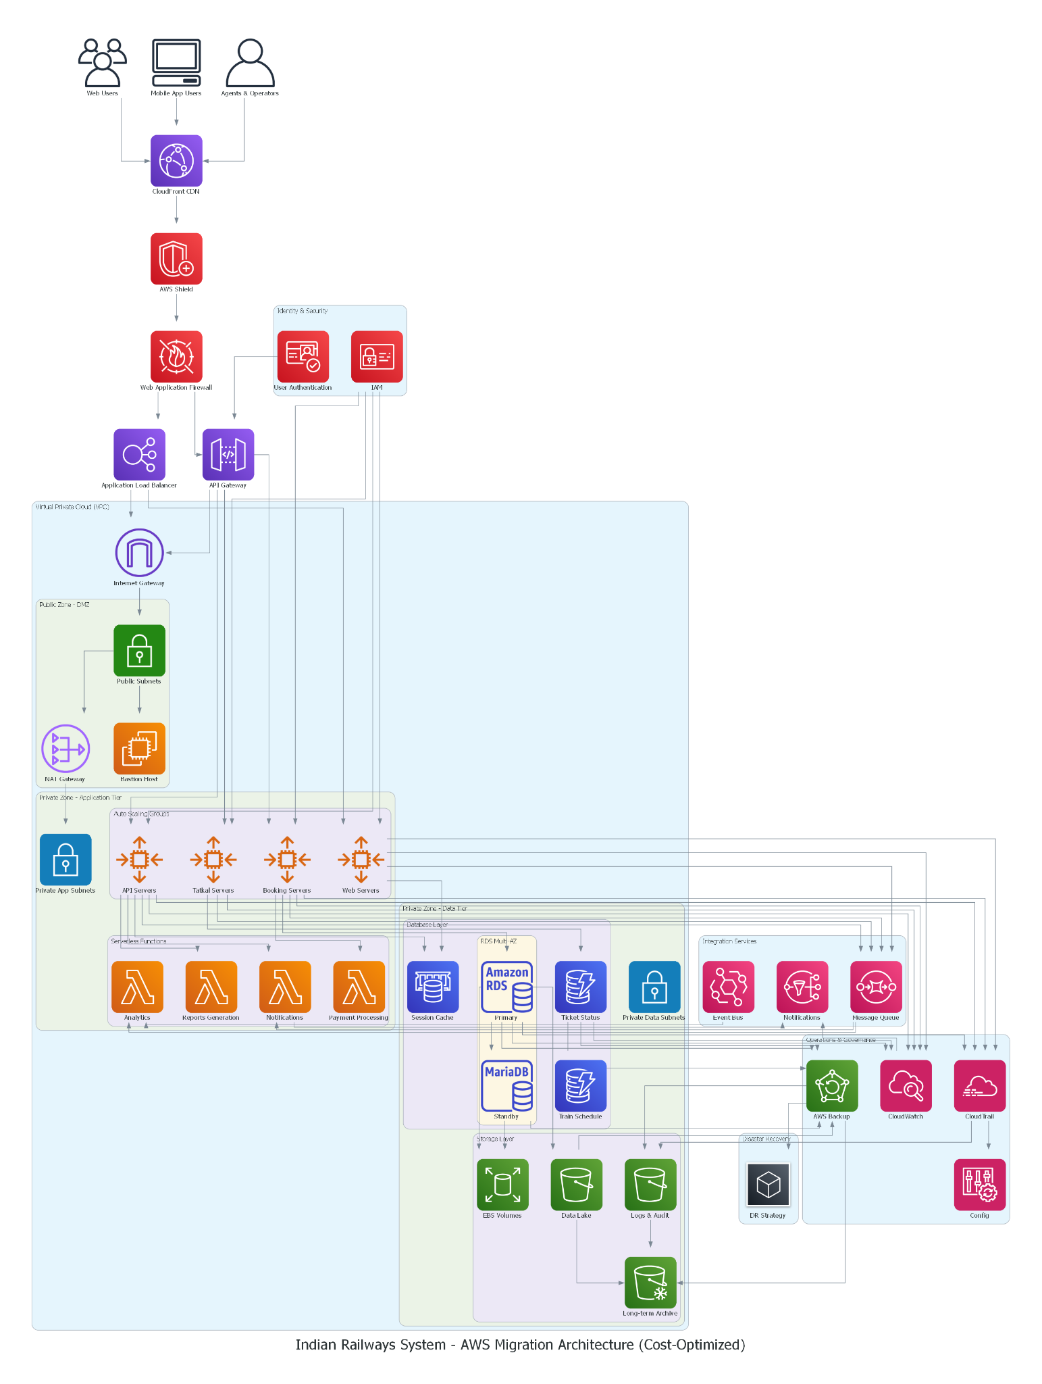
Proposed AWS Architecture Diagram for the Indian Railways System

Slide 26
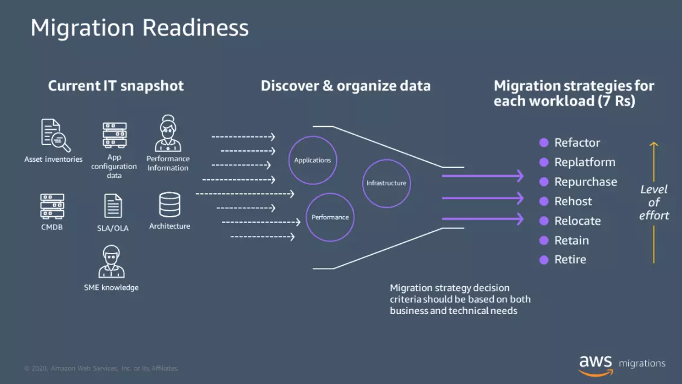
Cost Analysis of AWS Migration
Before Migration: On-Premises Costs
During Migration: Transitional Costs
After Migration: AWS Operational Cost

Slide 27
Before Migration: On-Premises Costs
Infrastructure Expenses: Costs associated with purchasing and maintaining physical servers, storage devices, networking equipment, and data centers.
Operational Costs: Expenses for power consumption, cooling systems, physical security, and facility management.
Personnel Costs: Salaries and benefits for IT staff responsible for hardware maintenance, network management, and system administration.
Capital Expenditures (CapEx): Significant upfront investments required for hardware procurement and infrastructure setup.

Slide 28
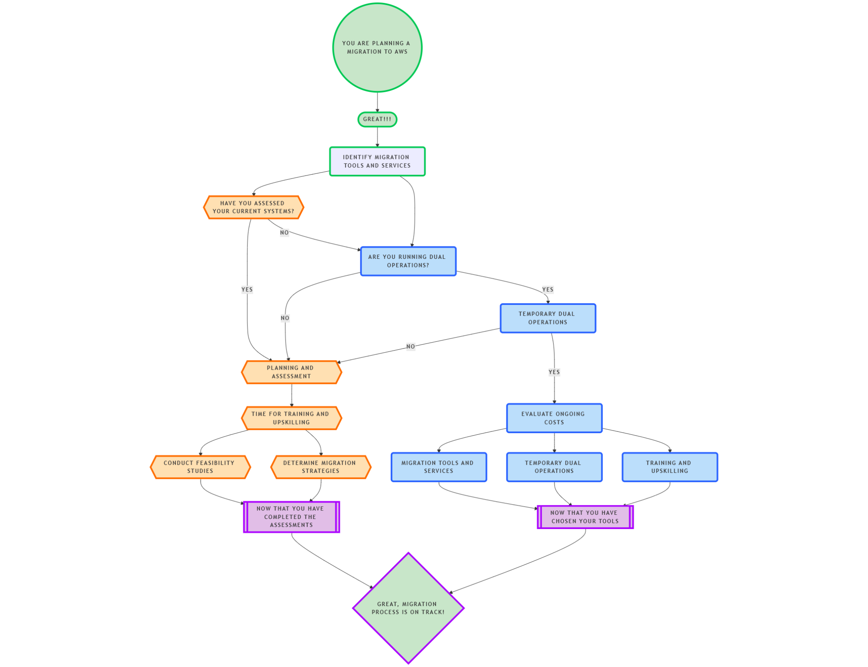
During Migration:
Transitional Costs
Planning and Assessment: Expenses related to evaluating existing systems, determining migration strategies, and conducting feasibility studies.
Migration Tools and Services: Costs for utilizing AWS migration services or third-party tools to facilitate data and application transfer.
Temporary Dual Operations: Expenses incurred from running parallel on-premises and AWS environments
to ensure business continuity during the transition.
Training and Upskilling: Investments in training staff to manage and operate AWS services effectively.

Slide 29
After Migration: AWS Operational Costs
Compute Resources: Costs based on the type and number of EC2 instances utilized, with options for on-demand, reserved, or spot instances.
Storage Services: Expenses for data storage solutions like S3, EBS, or Glacier, depending on access frequency and redundancy requirements.
Networking Costs: Charges for data transfer between AWS services, regions, or outbound to the internet.
Managed Services: Fees for additional AWS services such as RDS for databases, Lambda for serverless computing, or CloudWatch for monitoring

